Slide 1

CS2009-Design and Analysis of Algorithms Lecture 2
Course Supervisor: Anaum Hamid

Slide 2
Algorithms as a Technology
Suppose computers were infinitely fast and computer memory was free. Would you have any reason to study algorithms ?

Slide 3
Algorithms as a Technology
Yes, because if no issue with time and space then what about correctness of algorithm to solve given problem !

Slide 4
Algorithms as a Technology
Computers may be fast, but they are not infinitely fast. And memory may be inexpensive, but it is not free.
Computing time is, therefore, a bounded resource, and so is space in memory. You should use these resources wisely, and algorithms that are efficient in terms of time or space will help you do so.

Slide 5
Algorithms as a Technology
Different algorithms devised to solve the same problem often differ dramatically in
their efficiency. These differences can be much more significant than differences
due to hardware and software.
Example two different algorithms for sorting: Merge Sort and Insertion sort. Which is better in terms of time! Let’s discuss.

Slide 6
Algorithms as a Technology
Suppose Insertion Sort takes time = (c1 x n x n) = ( c1 x n^2 )
Suppose Merge Sort takes time = ( c2 x n x log n )
Which time is better ? Consider c1 < c2

Slide 7
Algorithms as a Technology
Then we see that where insertion sort has a factor of “n” in its running time, merge sort has a factor of “log n”, which is much smaller. (For example, when n = 1000, log n is approximately 10)
So merge sort is faster than insertion sort.
Although insertion sort usually runs faster than merge sort for small input sizes, once the input size “n” becomes large enough, merge sort’s advantage of “log n” vs. “ n” will more than compensate for the difference in constant factors. No matter how much smaller c1 is than c2, there will always be a crossover point beyond which merge sort is faster.

Slide 8
Algorithms as a Technology
Algorithm execution on Faster vs. Slower machine
Let us put a faster computer (computer A) running insertion sort against a slower computer (computer B) running merge sort. They each must sort an array of 10 million numbers. (Although 10 million numbers might seem like a lot, if the numbers are eight-byte integers, then the input occupies about 80 megabytes, which fits in the memory of even an inexpensive laptop computer many times over)

Slide 9
Algorithms as a Technology
Suppose that computer A executes 10 billion instructions per second (faster than any single sequential computer at the time of this writing) and computer B executes only 10 million instructions per second, so that computer A is 1000 times faster than computer B in raw computing power
To make the difference even more dramatic, suppose that the world’s craftiest programmer codes insertion sort in machine language for computer A, and the resulting code requires “2xn^2” instructions to sort n numbers. Suppose further that just an average programmer implements merge sort, using a high-level language with an inefficient compiler, with the resulting code taking “50 x n x log n” instructions

Slide 10


Algorithms as a Technology
To sort 10 million numbers, computer A (faster computer) takes :
To sort 10 million numbers, computer B (slower computer) takes :

Slide 11
Algorithms as a Technology
Result :
By using an algorithm whose running time grows more slowly, even with a poor compiler, computer B (slower computer) runs more than 17 times faster than computer A!
The advantage of merge sort is even more pronounced when we sort 100 million numbers: where insertion sort takes more than 23 days, merge sort takes under 4 hours. In general, as the problem size increases, so does the relative advantage of merge sort.
This is how slower machine can perform better than faster machine when algorithm running on slower machine is better than the algorithm running on faster machine for same problem.

Slide 12
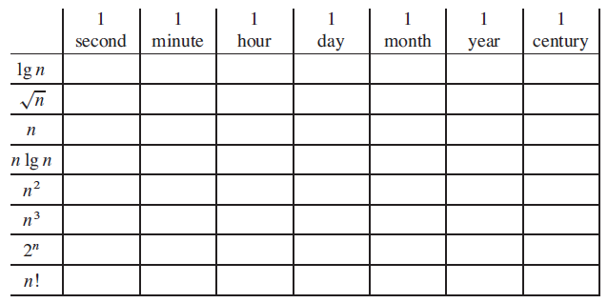
TASK: To be completed by next class
Comparison of running times
For each function f (n) and time t in the following table, determine the largest size n of a problem that can be solved in time t, if the algorithm to solve the problem takes f(n) microseconds.

Slide 13
